Slide 1
Money

Slide 2
Coins
A round piece of metal used as money
There are four main coins used in the United States

Slide 3
Penny Worth: 1 cent

Slide 4
Nickel Worth: 5 cents

Slide 5
Dime Worth: 10 Cents

Slide 6
Quarter Worth: 25 Cents

Slide 7
Paper Money
One Dollar = 100 Pennies 20 Nickels 10 Dimes 4 Quarters
Paper money can be used for bigger purchases

Slide 8
1 Dollar

Slide 9
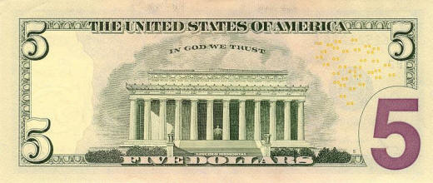
5 Dollar Bill

Slide 10
10 Dollar Bill

Slide 11
20 Dollar Bill

